Slide 1
DIPLOMAT MILENIAL Dalam Menghadapi Tantangan Global Kuliah Umum Fakultas Hukum Universitas Pancasila 20 Oktober 2022
Dr. Haryo B. Nugroho
Muhammad Taufan, Ph.D.
Ahmad Almaududy Amri, Ph.D.

Slide 2
Sekolah Dinas Luar Negeri/ Sekdilu) XXXII (2007)
S.H., Universitas Indonesia
LL.M., University of Virginia
S.J.D./ doctor of juridical science, University of Virginia
Dit. Hukum & Perjanjian Kewilayahan, Ditjen HPI, Kemlu
Elected Member Legal and Technical Commission, International Seabed Authority 2023-2027
Counsellor, PTRI New York
Deputi Asisten Utusan Khusus Presiden RI untuk Penetapan Batas Maritim RI-Malaysia
Sekretaris Ketiga, KBRI Washington D.C.
Dr. Haryo B. Nugroho

Slide 3
Sekolah Dinas Luar Negeri/Sekdilu XXXIII (2008)
S.H., Universitas Diponegoro
M.Si, Universitas Indonesia
LL.M., IMO International Maritime Law Institute
Ph.D, Flinders University
Dit. Hukum & Perjanjian Kewilayahan, Ditjen HPI, Kemlu
Vice President, Meeting of the State Parties to UNCLOS, 2021-2022
Counsellor, PTRI New York
Muhammad Taufan, Ph.D.

Slide 4
Sekolah Dinas Luar Negeri/ Sekdilu XXXV (2010)
S.H., Universitas Sumatera Utara
M.Si. Universitas Indonesia
M.H., Universitas Gadjah Mada
Ph.D., University of Wollongong
Dit. Hukum & Perjanjian Kewilayahan, Ditjen HPI, Kemlu
Advisor on Legal, Budget and UN Reform, Office of the President of the UN General Assembly, 75th Session
Sekretaris Pertama, PTRI New York
Founder @rostrumdiplomacy.id
Ahmad Almaududy Amri, Ph.D.

Slide 5
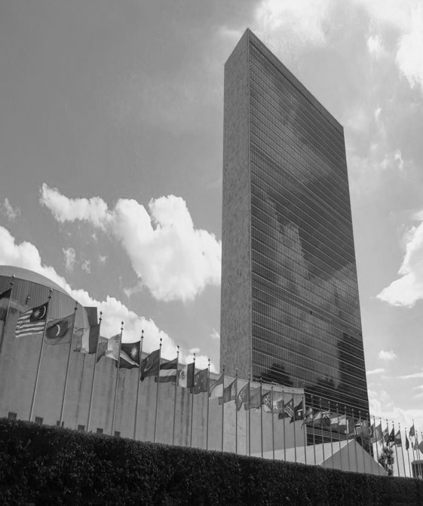
The Role of Diplomacy in International Relations
Ahmad Almaududy Amri, Ph.D.

Slide 6
“Diplomacy is to do and say the nastiest things in the nicest way” -Isaac Goldbrg

Slide 7
Outline
1. Diplomacy
2. Functions of Diplomatic Mission
3. Multilateral Diplomacy
4. Multilateral Negotiator
5. Career Mapping
6. Personal Branding

Slide 8
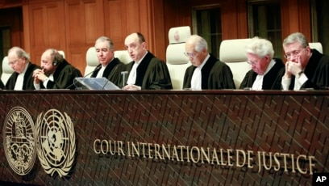
International Relations
Relations between states in all its aspects (politics, economic, development, etc) which are carried out to achieve state’s national interests
States are inter-connected and inter-related.
Respect, mutual benefit (peace and security, economy, development).
Bilateral, regional and multilateral ties.

Slide 9
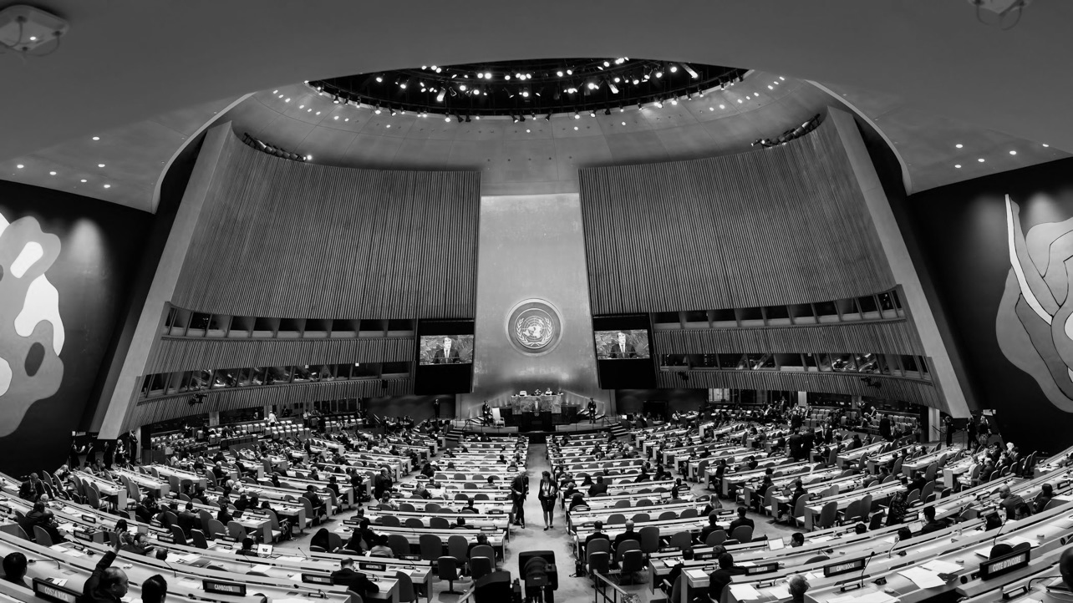
Diplomacy
Art to negotiate - representing your country
Tools of negotiation to make good relations
Communication process through officially recognized representative
Rhetoric: Persuasions
Most important tool in foreign policy

Slide 10
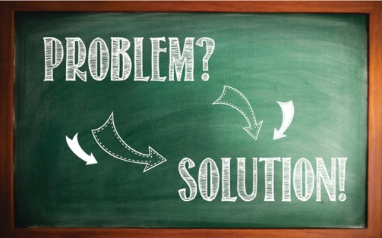
Challenges
Changes in geo-politic global and regional
Conflict between states dan territorial dispute
Trust deficit

Slide 11
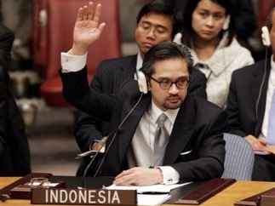
Functions of Diplomatic Mission (Vienna Convention 1961)
Representing
Promoting
Protecting
Negotiating
Reporting

Slide 12
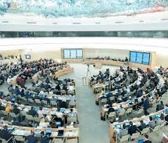
Multilateral Diplomacy in a Nutshell
Norm Setting Avenue
Aim: Putting member state’s ideal to international standard/ norm
Consensus – best outcome
Equal Right – Different Underlying Powers
Product: Resolution, Political Statement, Optic, Impression (brand)

Slide 13
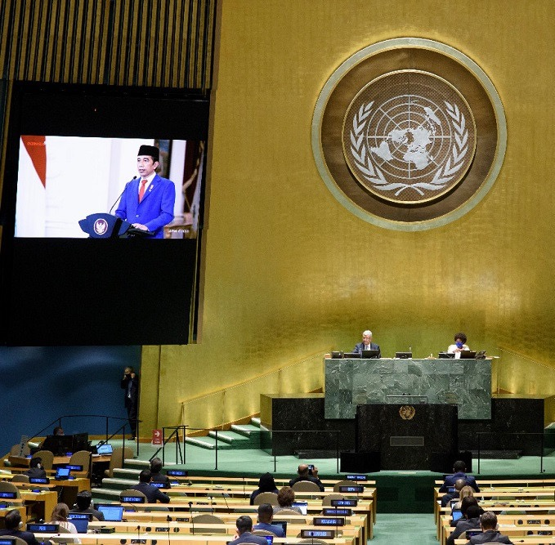
Multilateral Negotiations
Position Paper (Coord Kemlu)
Demarch (support gathering)
RoP
Groupings
Mandate
Agenda of Meeting
Product/ outcome documents

Slide 14
Multilateral Negotiator Traits
Sharp on spotlight, warm on low light
Strong library of Reference/ packed with rich institutional memory
Quick and Responsive
Know where to find
Corridor Master
Know their mandate and know everyone's position
Expert in Stakeholder Analysis Skills
Savvy, Pop, but should be taken seriously

Slide 15
Career Mapping
Merangkai yang abstrak menjadi nyata
Planning terhadap masa depan dengan terukur dan logis
Mengetahui langkah yang perlu diambil pada jangka panjang, tengah dan pendek
Start lebih awal dari yang telat sadar
Mencapai hasil yang maksimal: 3 in 1?

Slide 16
Personal Branding: 5 Characters
Repackaging and Rebranding
Mengasah Metode dan Sistematika Berfikir
Berbasis Teknologi
Collaboration and Empowerment
Connect and Inspire

Slide 17
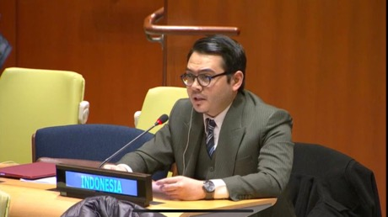
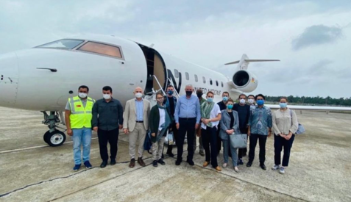
A diplomat who says “yes” means “maybe”
A diplomat who says “maybe” means “no”
And a diplomat who says ”no” is no diplomat
- Talleyrand

Slide 18
DIPLOMASI & TANTANGAN GLOBAL Berbagi Pengalaman dan Pengetahuan tentang Dunia Diplomasi di Era Kekinian Muhammad Taufan, Ph.D.

Slide 19
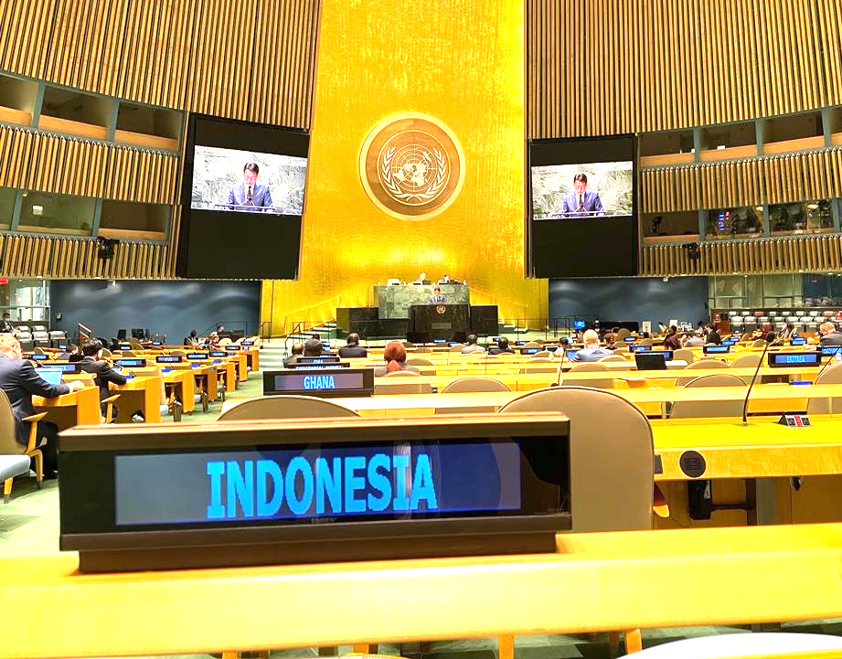
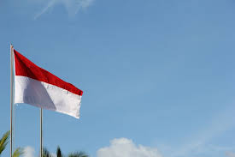
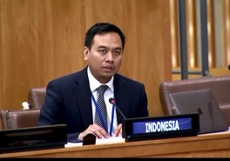
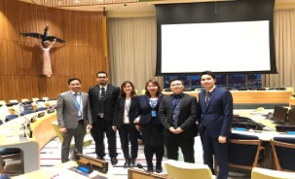
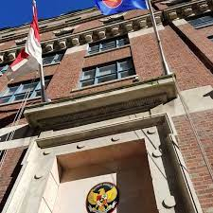
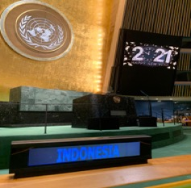

Slide 20
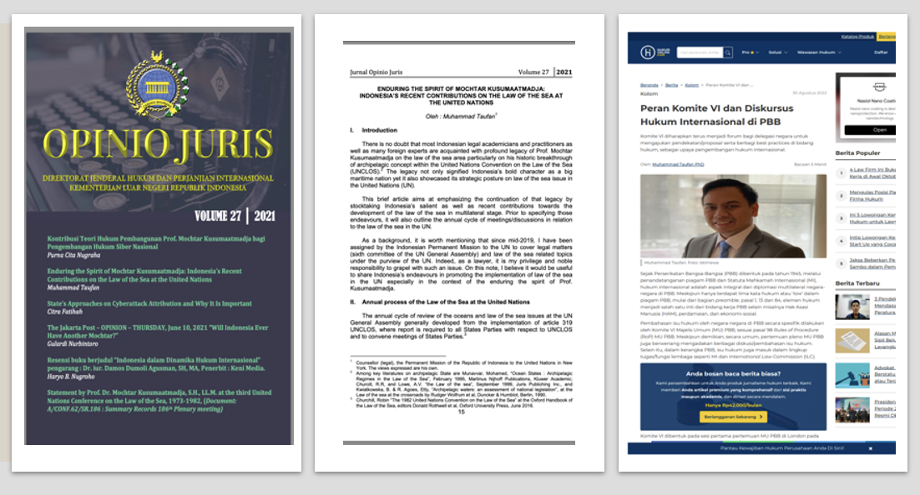

Slide 21
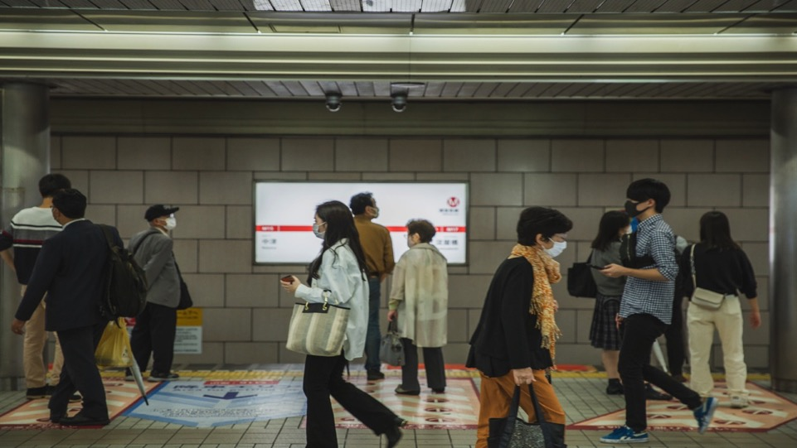
How is the New Normal Look Like?
To take into consideration:
New Rules of the Game
New Priorities
New Values and Standards
New Challenges
New Friends & Competitors
New Professions
New Skill Sets, Knowledge,
Etc.

Slide 22
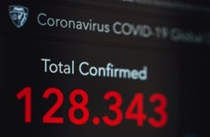
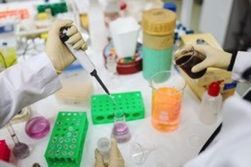

Slide 23
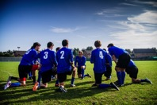
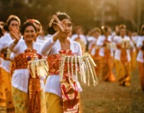
COMPETENCIES, CHARACTERS,SKILLS

Slide 25
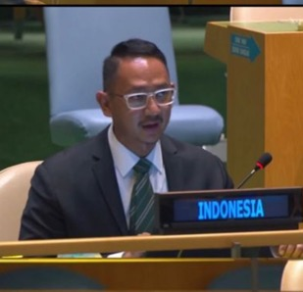
Contemporary Diplomacy
How contemporary is it?
Dr. Haryo B. Nugroho

Slide 26
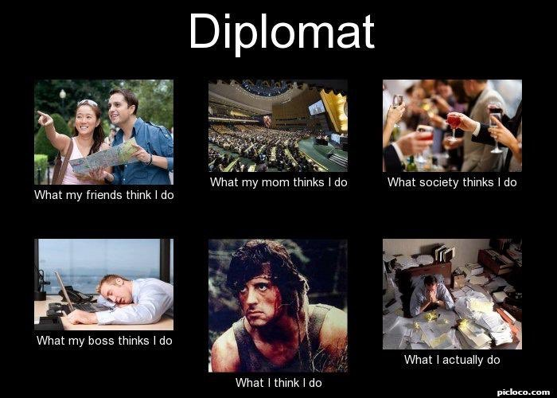
Traditional? Or Contemporary?

Slide 27
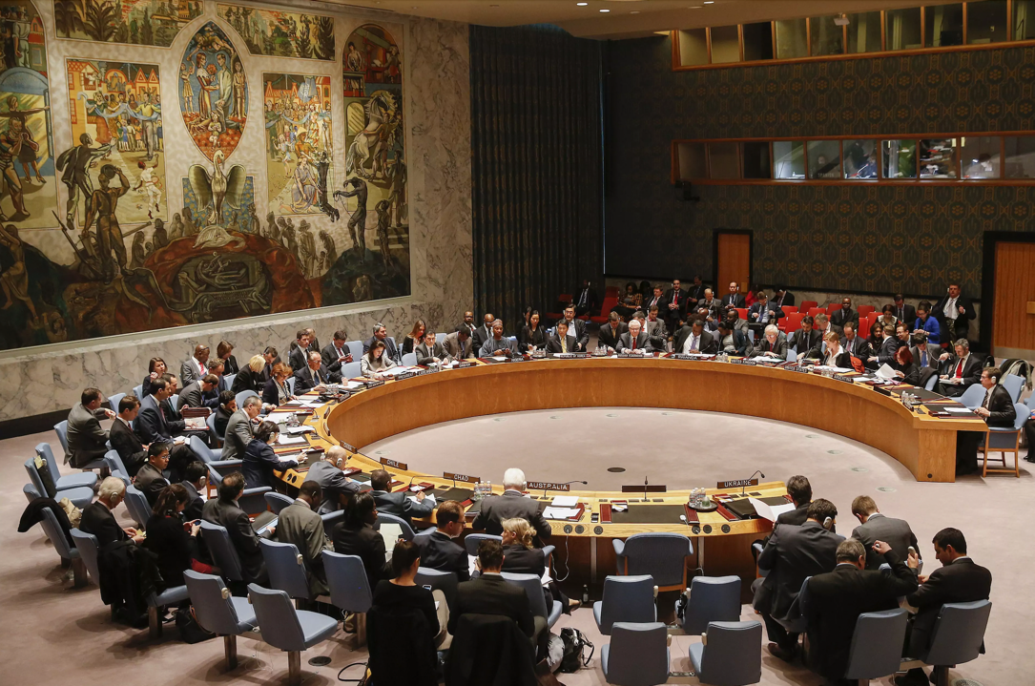
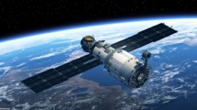
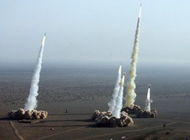
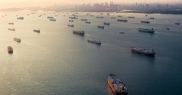
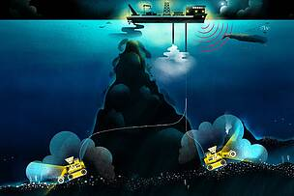
Issues that we are facing
and how are we handling them?
Traditional Issues
Emerging Issues
Futuristic Issues
Can traditional ways in diplomacy meet the challenges?

Slide 28
How to overcome the challenges?
Identify the problems and interface with other issues
Understand the history, key players and the dynamic of interests
Don’t stop with “where are we now” but continue to “what is next” AND the “what if?” scenarios
Utilize all resources, forum, avenues

Slide 29
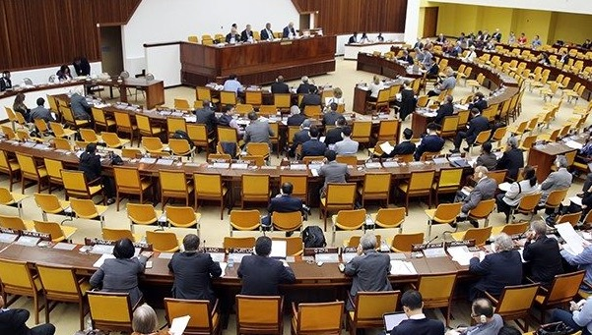
What are the KEYS?
Think outside of the box
There is no “one size fits all” approach
In Favor, Abstain, or Against
→ Play it well
Lobby + Coordination + Instructions
Reach wider audience

Slide 30
JOINING THE MINISTRIES ??

Slide 31
Dr. Haryo B. Nugroho
haryo.bn.ny@gmail.com
@poseijdon
Muhammad Taufan Ph.D.
muhammad.taufan@kemlu.go.id
taufan02@gmail.com
@taufanm02
Ahmad Almaududy Amri, Ph.D.
Ahmad.almaududy@kemlu.go.id
@dudyamri

